Slide 1
Deformation Transfer for Triangle Meshes
SIGGRAPH 2004
Robert W. Sumner
Jovan Popovic
(Massachusetts Institute of Technology)
Presenter: Arjun Prakash

Slide 2
Introduction
What is Deformation Transfer?
It is the process of transferring deformations from the source mesh to target mesh, keeping the identity of the target mesh.
Mapping facial expressions from one person to another or to a virtual model.

Slide 3
What is Researched
Copying deformations from one mesh onto another.
The research is purely mesh-based and does not require the two meshes to have same number of vertices or triangles.

Slide 4
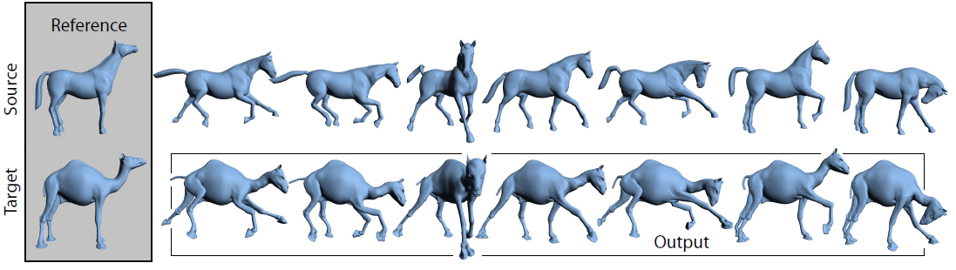
Application of Deformation Transfer
Figure: Deformation transfer copies the deformations exhibited by a source mesh onto a different target mesh. In this example, deformations of the reference horse mesh are transferred to the reference camel, generating seven new camel poses. Both gross skeletal changes as well as more subtle skin deformations are successfully reproduced.

Slide 5
Research Implementation Approach
Indicate the Source mesh and Target mesh.
Use Correspondence to build a map know as Correspondence map.
Pairing is done between source vertices and target vertices.
Optimization is done to align triangles.
Find Correct coordinates of the Shared Vertex.

Slide 6
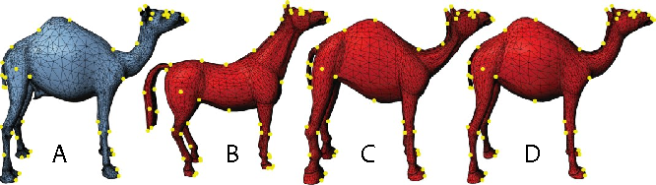
Correspondence
Correspondence map is built between the triangles of the source mesh and the target mesh.
This is done by specifying a small set of vertex markers.

Slide 7
Correspondence
With the aid of correspondence map, An affine transformation is computed for each triangle of the source mesh, that takes the triangle from its original position to its deformed position.
These affine transformations, together with the correspondence, specify the ideal change in Orientation, Scale, and Skew of each triangle of the target shape.

Slide 8
Non-Transitional Portion
Transformations will not, in general, be consistent with respect to one another.
If Affine transformations are applied directly without modification, the transformations would not preserve the connectedness of the target mesh.
There is non-transitional portion of each Affine Transformation that manages the change of orientation.

Slide 9
Preserving Connectedness
The three vertices of a triangle during deformation do not fully determine the affine transformation since they do not establish how the space perpendicular to the triangle deforms.
To resolve this issue, we add a fourth vertex in the direction perpendicular to the triangle.

Slide 10
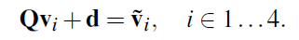
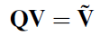
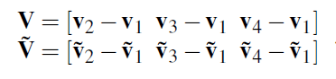
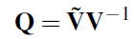
Modified Matrix
Affine transformation: Q + d
Q -> 3X3 matrix, d -> Displacement vector
Vi -> Undeformed Vertex
Ṽi -> Deformed Vertex

Slide 11
Pairing between source and Target Mesh
In order to relate the source deformation to the target mesh with the set of triangle indices T, the user supplies a mapping M between the set indices for the source and target triangles:
This pair indicate that the Target triangle with index ti should deform like the Source triangle with index Si.

Slide 12
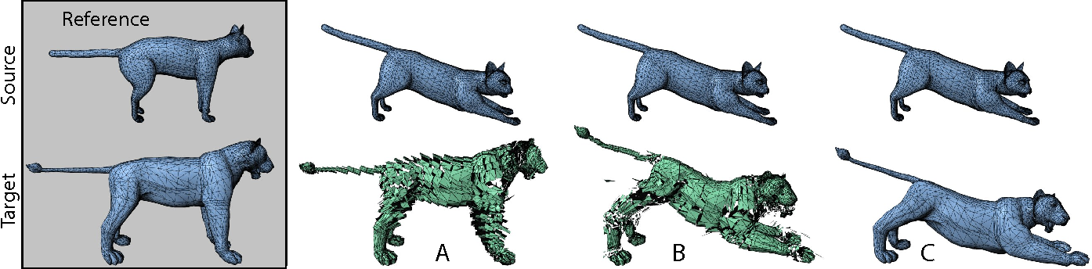
Shared Vertex
There is non-transitional portion in the source transformation. So for that we need a common vertex between the source mesh and target mesh vertex.

Slide 13
Shared Vertex: For mapping at same position
Affine Transformation : Q + d
Figure A: ‘Q’ only encodes the change in orientation and size and not the positioning of the triangle relative to its neighbour.
Figure B: The Displacement vector was also not used as their lengths depend upon size and position of the shape.
Figure C: In order to ensure the affine transformations, we require the shared vertex be transformed on the same place.

Slide 14
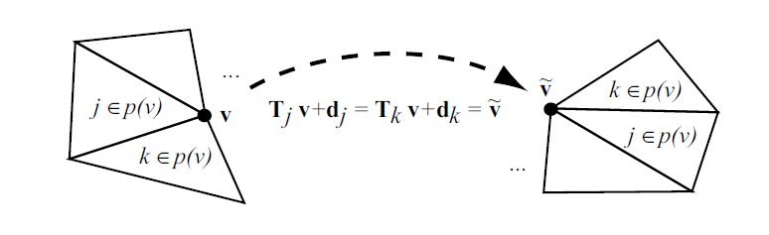
Shared Vertex
Just to ensure affine transformations, when applied to target mesh, are consistent, we require that shared vertices be transformed at the same place.
This step minimized the non-transitional component.
Figure: In order to maintain consistency, the affine transformations for all triangles that share vertex v must transform v to the same position.

Slide 15
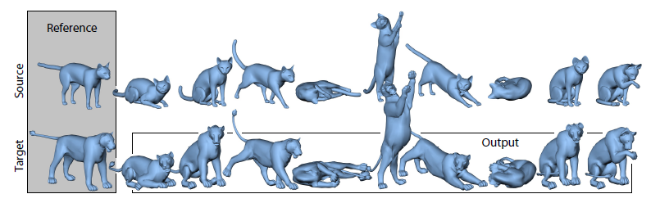
Result
The input to the algorithm is the reference Cat mesh, the seven deformed Cat poses, the reference Lion mesh, and the correspondence between the two reference meshes.
Given this data, deformation transfer generates seven new Lion poses by transferring the source deformations onto the reference Lion.

Slide 16
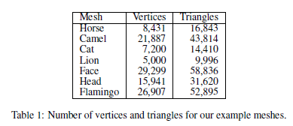
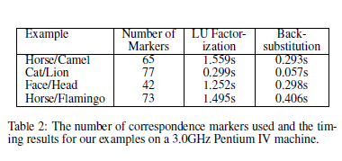
Result
The Camel mesh, consisting of 21,887 Vertices and 43,814 Triangles, required only 1.559 seconds for factorization.
And 0.293 seconds on average to solve each retargeted pose.

Slide 17
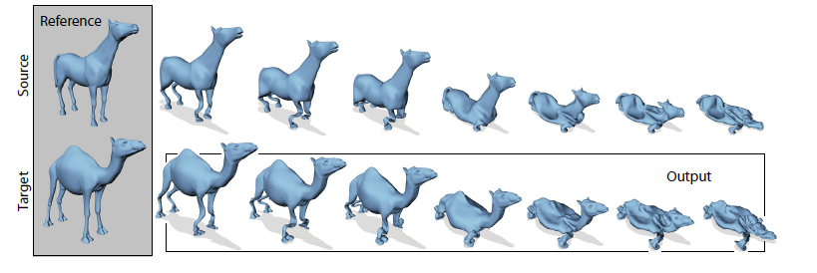
Result
Testing was also done by Collapsing the horse.
(Show Video)

Slide 18
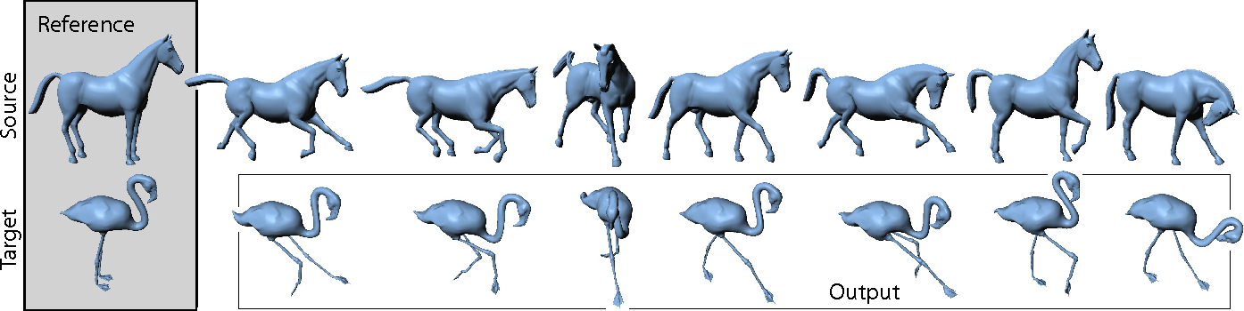
Conclusion
This method was challenged by changing the skeleton structure of the target mesh. And as a conclusion the results were correct.

Slide 19
Demonstration Video

